Slide 1
Oslo Medtech – innovation and international collaboration in medical technology
Ane Solesvik Oppedal, International Project Manager Oslo Medtech, July 2015

Slide 2
Oslo Medtech
A Norwegian health technology cluster with the aim to develop and industrialize world class health technology products and services that enables sustainable and high quality treatment and care, and Norwegian Medtech industry growth

Slide 3
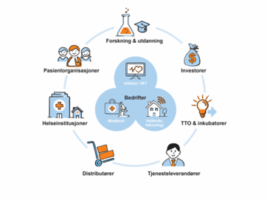
From ARENA to NCE

Slide 4
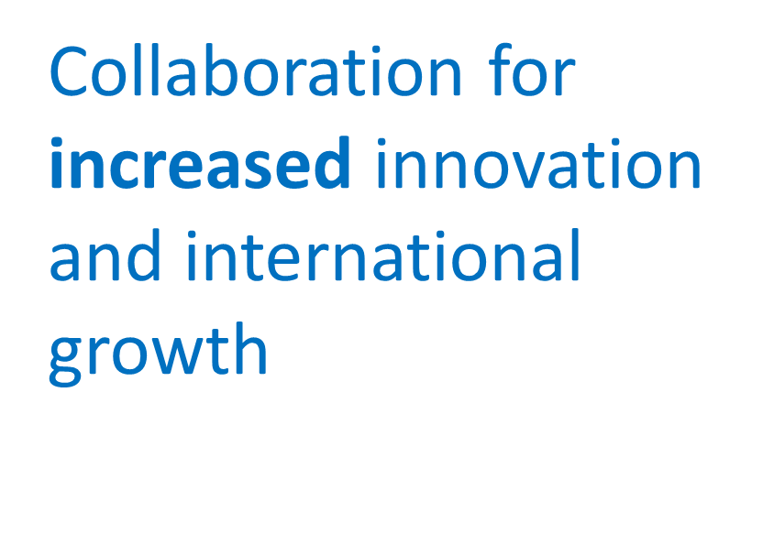
The cluster Oslo Medtech

Slide 5
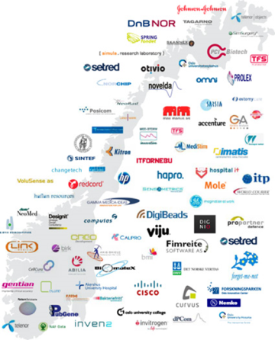
Oslo Medtech key figures
Founded November 2009
Cluster, organized as a nonprofit membership organization
180 members
The full health value chain represented
37 bill NOK turnover in 2013
Partner in Innovation Norway cluster program since 2009

Slide 6
Stimulate and facilitate for innovation and growth
Facilitate cooperation between R&D, companies and hospitals/local authorities
Stimulate and facilitate market driven innovation projects and procurement processes
Facilitate clinical trials and testing
Enhance the knowledge of International markets and help companies to reach the global market
Attract development and investment capital
Co-housing in Medtech Growth House

Slide 7
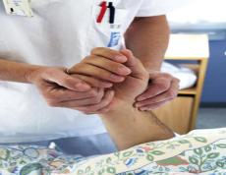
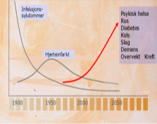
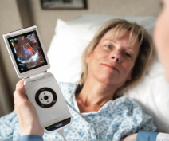
Norwegian and global societal trends and challenges
Less hands
In healthcare
Demografic changes
Healthcare costs
Access to technology
In Norway – every 3rd student in high school will be needed in the health sector
2035: 45 % of Nordic population – and 20% of the worlds population 60+
17% of Norwegian GDP on health
Focus on reducing costs
Globalization and techno-logical revolution = new market possibilities
Medicine & healthcare becomes technology dependent!

Slide 8
New service and business models

Slide 9
…By using sensors in homes and on patients (connected care)

Slide 10
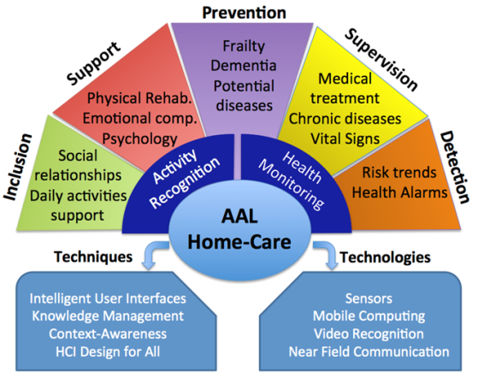
From treatment to prevention to inclusion…

Slide 11
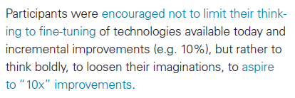
Catalyzing Technology to Support Family Caregiving

Slide 12
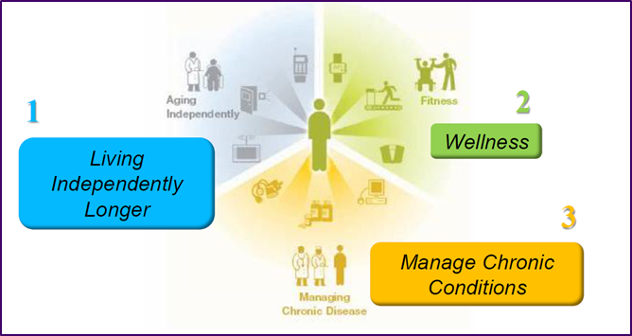
Living independently

Slide 13
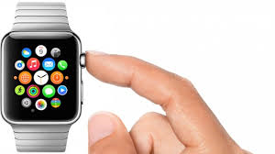
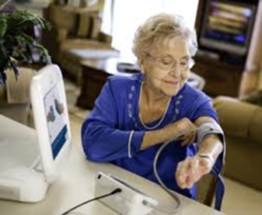
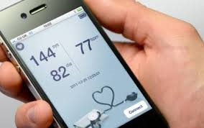
Mobile health applications

Slide 14
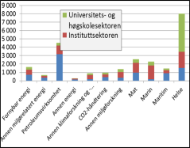
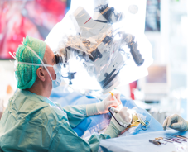
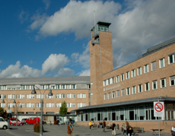
Norwegian potential and competitive advantage
Public investment in R&D
Int. attractive testfacilities
Well-estblished health system
Early adopters
9 bill NOK ye. in Health R&D
6 bill in Oslo region
2nd largest R&D industry
Test on animal and human in same place
60 % from international companies
Quality in focus
Economy to test out and implement new solutions
Innovative mindset
Gives dignity!

Slide 15
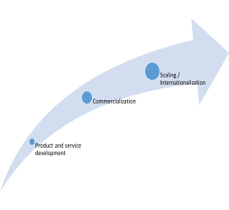
From market need to industry growth
World Wide Growing Markets
Develop world class health technology solutions
Industry growth and value creation
Demographic changes
The increase in chronic diseases
Need for efficiency and quality in diagnostics and treatment
Need for health care administration efficiency and quality
Fitness and Wellness
Customer driven and cluster based innovation and development

Slide 16
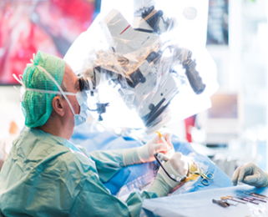
Focus areas
Focus on the radical and disruptive changes and technology that will:
Improve the quality and efficiency of monitoring, diagnostics, intervention, treatment and follow up
Improve the patient life quality
Reduce the health care cost dramatically

Slide 17
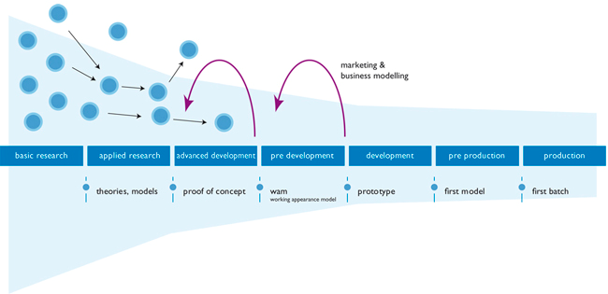
Medtech Accelerator

Slide 18
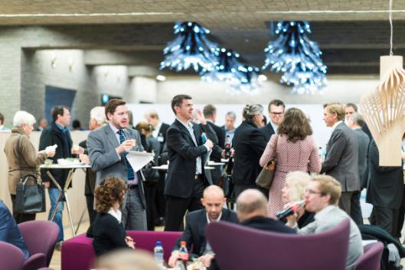
Medtech Investor Network
Oslo Medtech builds up an Medtech Investor Network – and match investors and companies
DNB-Oslo Medtech Investment Conference
December 15th 2015

Slide 19
International outreach
Norwegian, Nordic and international markets
Oslo Medtech add value by:
Facilitate international R&D projects
Build “Go to market” competence
Regulatory issues and reimbursement
Market potential and barriers
“How to build an international strategy” …etc
Financing, people and team
Connect with experts, distributors and “market players”

Slide 20
Oslo Medtech EU program
Information on calls
Help companies to find consortium partners (cluster-to-cluster collaboration)
Help with writing applications
Professional quality check of applications
US companies as partners
«Fit for Health 2.0» – Health, demographic changer and well-being
Sub-contracting: 60 000 Euro

Slide 21
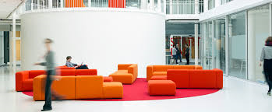
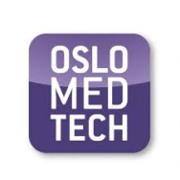
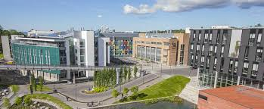
Collaboration: Minneapolis - Oslo

Slide 22
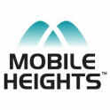
Cluster to cluster collaboration – Main aim
By making use of the already established trustful relationships, established by the clusters in their «home arena», open up the «gateways» for collaboration on development, clinical trials, and market access for the health technology companies

Slide 23
Cluster to cluster collaboration
Nordic Clusters | International clusters
Mobile Heights/Technolpolis (SE) | Life Science Allley (USA, Minneapolis)
Future Position X (robotics/gaming) (SE) | Healthcare Cluster Portugal (PO)
Nordic Medtest/Compære (SE) | Berlin Brandenburg Region (DE)
Helseklynge Reykjavik (IS) | Centre eSanté (FR)
Welfaretech (DK) | Cap Digital (FR)
Copenhagen Medtech (DK) | Health Cluster Net (UK)
Delta (DK) | Medtech Switzerland (SWISS)
Cobis (DK) | Cluster de Salud de Castilla y Leon (ES)
Oulu Business (FI) | Eurob Creative (ES)
NCE Systems Engineering (No)
Norwegian SmartCare Cluster (No)
Oslo Cancer Cluster (No)
Nansen Neuro Science (No)

Slide 24
Collaborating testfacilities
Name testbed | Nationality
Intervention Centre, Oslo University Hospital | Norway - Oslo
Sunnaas testfacility, Sunnaas hospital | Norway - Oslo
C3 – Living Lab | Norway - Oslo
Karolinska University hospital | Sweden - Stockholm
Nordic Medtest | Sweden - Karlstad
SLL Innovation | Sweden - Lund
Sahlgrenska Science park | Sweden
Helsinki University Hospital | Finland - Helsinki
Innovation Centre Island | Island - Reykjavik
NHS network of testbeds | England - London

Slide 25
Follow us on @OsloMedtech OsloMedtech Contact www.oslomedtech.no mail@oslomedtech.no
25

