Slide 1

The significance of open access to medical records
The Danish eHealth portal
Anne Løhndorf
Head of web & communication
Notes:
Thank you for giving me the opportunity to tell you about the Danish e-Health Portal sundhed.dk.

Slide 2
Today’s agenda
Introduction to the Danish eHealth portal
Benefits of eHealth and open acess to medical records
Organization and succesful implementation
The future and cooperation across borders
Notes:
I’ll begin by giving you an overall introduction to the Danish eHealth portal sundhed.dk and some examples of best practices.
Ill talk about how eHealth improves the quality of the services offered to patients.
I’ll finish by talking a bit about our experiences with implementing eHealth – what are the requirements in order to convince stakeholders, healthcare professionals and patients to participate? What is required to be successful with eHealth?
And finaly, I will say a few words about the future and the possibilities of cooperation across borders.

Slide 3
Sundhed.dk
The public health care system online
Citizens
Personal services
Data/records
Health professionals
Patient data
Administrative tools
    > 1,300,000 unique users / month
    Most applied application amongst health professionals
Notes:
The name of our portal is sundhed.dk – sundhed meaning health. The portal has more than 1,3 million unique visitors per month. That is a lot, out of a population of about 5,6 million.
Sundhed.dk offers general information about health for the citizens, but more importantly it gives anytime anywhere access to personal health data.
Similarly, for health professionals, it provides general health information and serves as an administrative tool. Most importantly it is a gateway to patient data that are not accessible in their own systems. E.g. GP’s can access patient records from hospitals, waiting lists, and contact information for other health professionals. A doctor working at the hospital in one region can access records from a hospital in another region of Denmark.

Slide 4
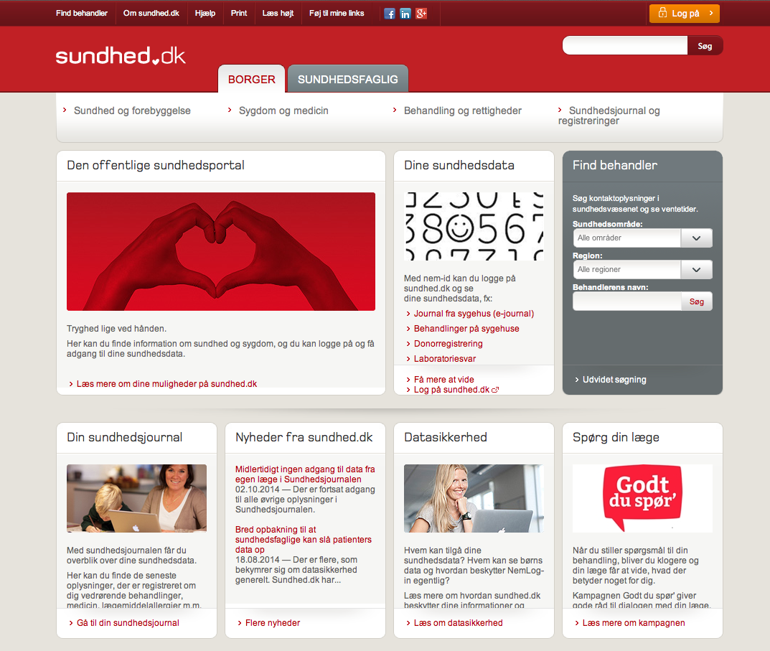
d
Notes:
And this is what it looks like, the danish ehealthportal.
You can access:
General information about health and about how to find your way through the Danish health care system
Personal health records when you log on with the Danish certificate (nemId)
The tabs in the top bar indicates, that you can visit the portal as citizen or as health care professional and find information targeted you.

Slide 5
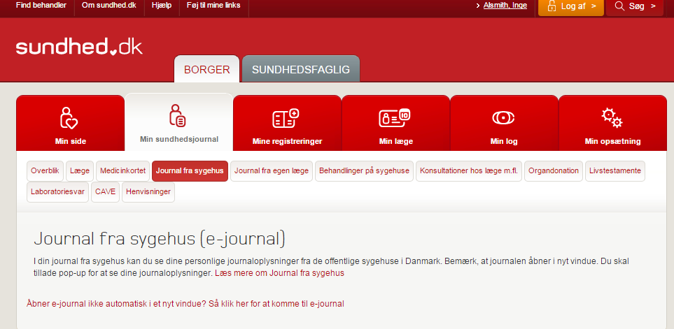
Notes:
The portal offers citizens a full access to and overview of their personal health data:
Online Electronic Health Record from hospitals
Cross-sectorial personal electronic medicine profile
Overview of personal medical history since 1977 (list of contacts with hospitals)
Overview of contact with primary sector clinics since 2003
Lab tests
Online Organ Donor Registration
Online Living Will
It-services for patients with chronic conditions
Finally we provide a service called ‘My log’ that allows the individual patient to see which health professionals have accessed their personal data – which points back to the very important aim of ‘Secure and coherent digital communication’

Slide 6
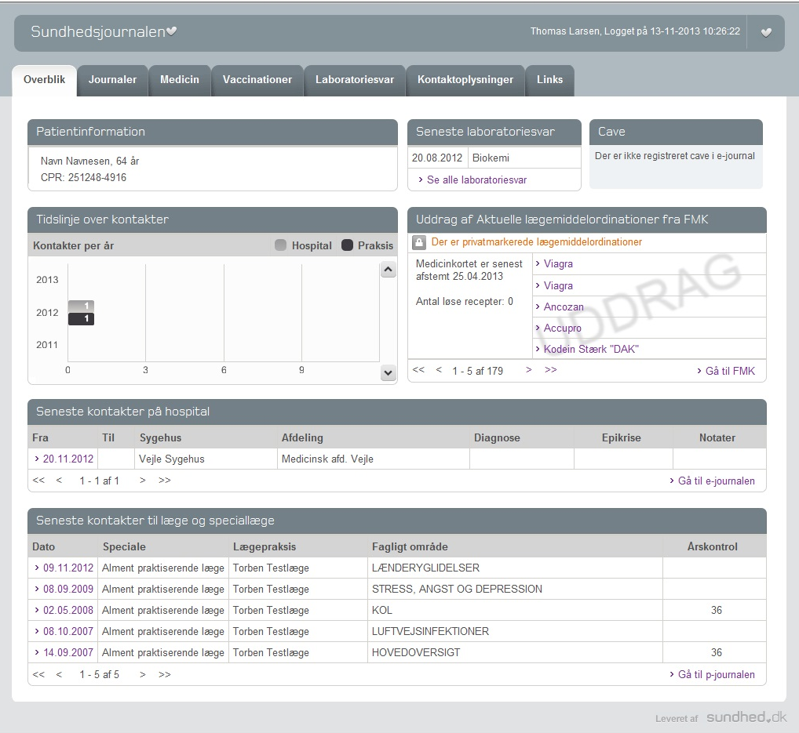
Hospitals’ Online Electronic Health Record
Notes:
The portal also offers full access for health care professionals at the Danish hospitals to the patients health records. If a doctor at a hospital wants to access national data that is not produced or available within the local system, they can find a link to the national portal and find it there.
Online Electronic Health Record from hospitals
Cross-sectorial personal electronic medicine profile
Overview of personal medical history since 1977 (list of contacts with hospitals)
Overview of contact with primary sector clinics since 2003
Lab tests

Slide 7
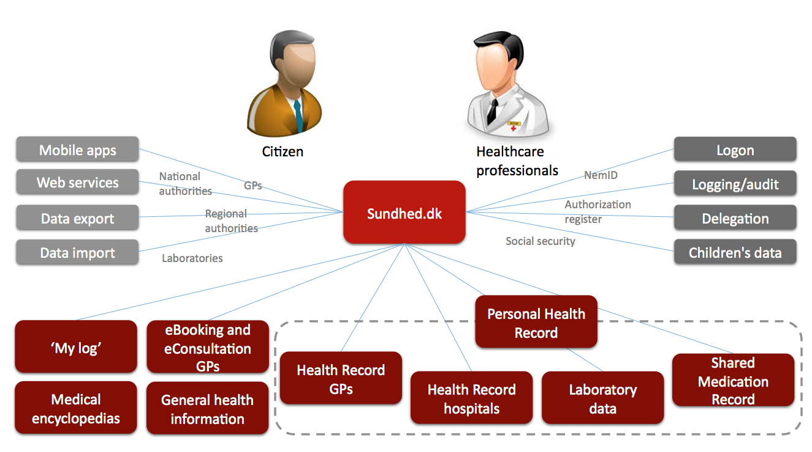
E-HEALTH LANDSCAPE
Notes:
Sundhed.dk is not just a front end portal.
It’s also a powerful back-end integration platform including data from 120 existing sources.
Sundhed.dk is essentially a ‘backbone’ of the Danish national e-health infrastructure.
It provides an (almost) 100 % coverage of EHRs at hospitals and in primary health care.
We are developing the services alongside, and recently we launched next step in “Shared medication Record” (FMK) (PEG!) showing complete and current medication on all patients – The new ad on means that parents can now also access their children’s medical outline.
Hopefully you have an overall idea of the portal and the services it provides citizens and health care professionals.

Slide 8

Benefits of E-health & open access to medical records
Notes:
Why is open access to medical records important and does it actually make a difference for the patients? My answer is YES! And this is why

Slide 9
Understanding information from health professionals
Activation &
Co-playing /commitment
Increase in self care
Appropriate use of the health system
Knowledge & information
Health equity
Patient
Empowerment
Notes:
It is all about Patient Empowerment!
Patient empowerment means a whole process of involving the patient. Not only giving access to relevant information but also giving the patient an active role as a co-player in the treatment process.
In short, e-health helps people be healthy! Simply, we can measure that in scientific research.

Slide 10


Not only the resourceful
Low income
No/low education
Unhealthy lifestyle
Rarely consults GP
Needs motivation
Notes:
Open access to medical records are also essential for less resourceful citizens.
we know there’s a group of citizens that - at least at first sight - is not really interested in health and regards the public healthcare sector as a rather irrelevant and distant agent. However, last year we made a survey that surprisingly showed us that these people do use sundhed.dk. That means we can activate these people as they do have the potential and the resources to play an active role in their own health condition. But they need someone to help and guide them – being a GP or a family member which leads me to my next statement.
To illustrate how access to data can help patients – in this case a diabetes patient , I’ll show you a short video

Slide 11

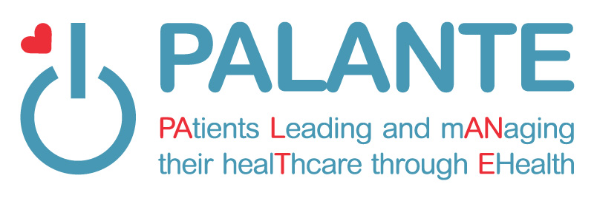
Measurable Effect
Notes:
WE have been part of a European Survey – PALANTE – asking citizens how they have experiences the open access to medical records.
Here’s is what they answered:

Slide 12
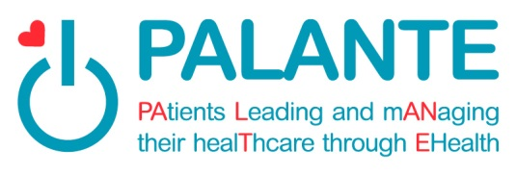
Measurable Effect
24 % Improved course of treatment
41 % Better understanding of one’s health
36 % Additional advantages
92 % E-data should still be accessible.
Notes:
24 % experience improved course of treatment
41 % are saying that the acces leads to a better understanding of one’s health
36 % experince additional advantages
92 per cent state that they believe e-data should still be accessible to citizens

Slide 13
Well prepared and active patients – adding value
Time saving systems
Coherent approach to diagnostic and treatment
Complex data available for research leading to better treatment
High quality patient information across the health services
Efficient Healthcare System
Notes:
Also, for the health professionals there are also some obvious benefits to open access to medical records: Let me mention
Data sharing is time saving, and you get a coherent approach to diagnosis and treatment. The health professionals get quality patient information from across the health services.
The healthcare professionals will meet well-prepared patients that are active players which is a most important factor in shaping a efficient health care system.

Slide 14
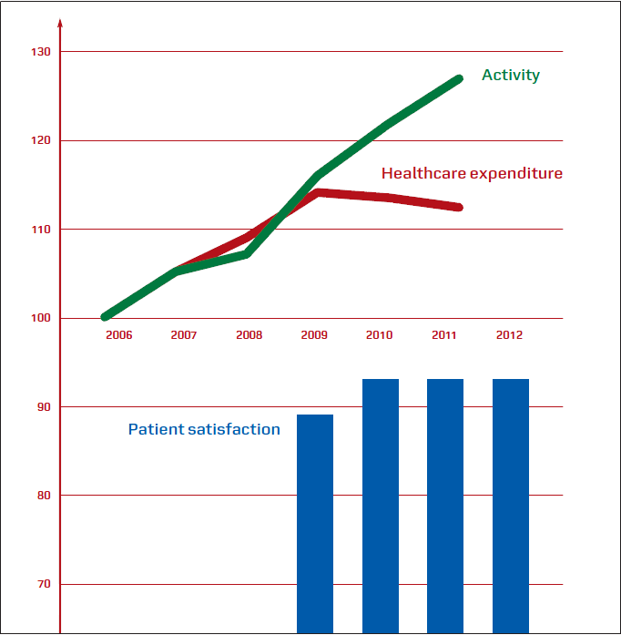
Notes:
The economic idea of the portal is to help keeping the citizens out from the expensive hospitals and keep the citizens out Where it is most comfortable and nice to be; at home or at the GP sector. The focus on the GP-sector is on lifestyle, prevention and chronic diseases.
The GP sector in Denmak covers everybody and it is free of charge. It is funded by the taxpayers and it costs about 200 euro a year pr. Dane for full coverage. 90% are kept in the GP Sector, but if it changes so that only 89% are kept out there – and 11 percent go to the hospitals - then the waiting list at the hospitals increases between 10 and 15 %. So it’s very important.
The digitization of health services occurs and portal traffic grows - as I demonstrated on an earlier slide - while the Danish healthcare system experiences increased activity and improved patient satisfaction.
At the same time, we see that overall spending stagnates as the red line shows… (vis den røde!)

Slide 15
ORGANIZATION and succesful implementation
Owners’ Board
Representatives from:
State, regions, municipalities
Steering Committee
secretariat
CEO
Web & communication
IT development
IT operations & infrastructure
Administration & Staff functions
Innovation
Notes:
The owners’ board and the steering committee both reflect that the portal is owned by all public health authorities across sectors.
Sundhed.dk’s success is to make state, regions and municipalities succes and deliver their it-strategies. We need to be very close to our owners to:
Make it easy for them to succeed
Make sure, that our product lives up to the needs in state, regions and municipalities.

Slide 16
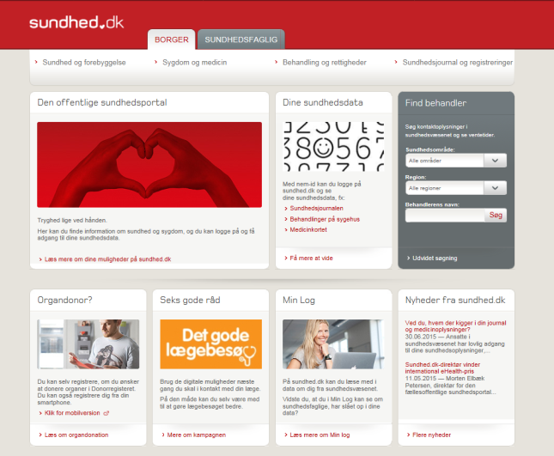
CO-OPERATION & network
Secretariat
PARTNERS:
5 Danish Regions
Ministry of Health
National Board of Health
Patient Insurance Association
National Agency for Patients' Rights and Complaints
98 Municipalities
Group of contact
persons
/ambassadors
Contact
persons
Group of
GP webmasters
Content to CMS
Projects
Notes:
The partners take part in the decission making structure. And at an operational level they also participate in networks facilitated by sundhed.dk.
Here you can see the setup of coperation and that each of our partners can contribute with content and projects and can participate in group of Liæsons. ( Liaison)
The partners are invited to define their needs in every project, they edit directly in the content management system, the group of liaisons are involved in implementing the communication in their own organisations and on their own platforms.
Sundhed.dk as an organisation is:
Experts in it, communication and infrastructure
Consultants in very complicated cross sectorial projects
Facilitators of well functioning networks supporting the over all idea and the implementation in state, regions and municipalities.

Slide 17
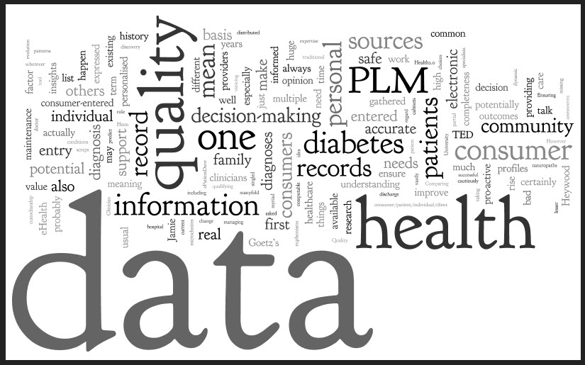
The Future Healthcare system?
Notes:
Finally - I’ll spend a few moments on what the future looks like from my position… I think that we have only taken the first steps in the revolution of e-health. The coming years we will see an increase in quality data across the healthcare sector.
An important milestone is accessing this data not from the computer but from a tablet or smart phone, giving both patients and health professionals the freedom and flexibility of mobile access. Today, you CAN access our portal from a mobile or tablet but we are still working on the solution that must be more user-friendly and better. However, already 40 percent of our users access the portal from mobile devices.
It is not only about HOW the data is accessed but even more about WHO and WHEN. Through mobile access the patient can contribute with much more data on-the-go given a much more coherent, yet complex and dynamic picture of the patient’s health situation. There’s no doubt that the future will reveal many interesting and even explosive developments that we at sundhed.dk will follow and take active part in!

Slide 18
Cooperation across borders
The Danish e-health portal attracts attention worldwide.
During the years the organisation has cooperated and been in professional dialogue with around 35 countries, e.g. Croatia, Estonia and Lithuania.
We are part of public and private cooperatives.

Slide 19

Notes:
If we still have a few minutes I’d be happy to answer any questions?

